Slide 1
Changes in Population due to Migration of Young Puerto Ricans
by Luis Millet & Gian F. Villafañe

Slide 2
TABLE OF CONTENTS
01
02
03
04
Hypotheses
Demographical, Political and Natural deistaurs
Data Sources
Accessing data through API, CSV and Excel formats
Data Analysis
Comparison of census data between P.R. & the U.S.
Findings and Interpretation
Interpretation of results in relation to hypotheses

Slide 3
INTRODUCTION
Project Objective: This project aims to investigate the influence of various phenomena and events that have occurred in Puerto Rico on the migration patterns of Puerto Ricans leaving their island.
Data Analysis: Analyzing census data from Puerto Rico and the data from The World Bank on "Net migration" spanning the years 2015 to 2022.
Understanding Migration Dynamics: Through this analysis, we seek to understand the demographic trends and factors driving the migration of Puerto Ricans.

Slide 4
01
Hypotheses

Slide 5
Hypotheses
Demographic Trend Hypothesis: The majority of individuals migrating from Puerto Rico during the period from 2015 to 2022 are younger than 30 years old, driven by variations in job availability, wages, and quality of life.
Policy Influence Hypothesis: Changes in federal policies and governance, including the implementation of PROMESA in 2016, influenced migration patterns of Puerto Ricans.
Natural Disaster Impact Hypothesis: Natural disasters such as Hurricane Maria in 2017 resulted in a significant temporary surge in migration from Puerto Rico.

Slide 6
02
Data Sources

Slide 7
Data Sources
In our analysis, we utilized two primary data sources. The first is the Census S0101 Age & Sex dataset, which provides comprehensive demographic breakdowns by age and sex, offering detailed insights into population dynamics. Our second source is the World Bank's Net Migration dataset for Puerto Rico. This dataset tracks migration patterns, giving us a clear picture of demographic changes over time in Puerto Rico due to migration trends..
Additionally, our hypotheses are supported by several previous studies that have explored similar themes. These studies provide a robust foundation for our analysis, confirming trends observed in our primary data sources and enriching our understanding of demographic and migration dynamics. Their findings have been instrumental in shaping our approach and validating our analytical methods.

Slide 8
03
Data Analysis

Slide 9
Data Analysis
In our analysis of demographic trends in Puerto Rico, we observed a significant decline in the overall population. From 2015 to 2022, the total population decreased from 3,583,073 to 3,272,382. This decline is indicative of demographic shifts within the territory.
During the same timeframe, there were notable changes in the age composition of the island. The median age increased from 38.7 years in 2015 to 43.7 years in 2022, suggesting an aging population with fewer young people.
This shift is further evidenced by the substantial decrease in the population aged 0-35 years, which decreased from 1,623,132 to 1,292,907. These figures highlight the challenges of an aging demographic, which may have significant implications for the economy.

Slide 10
04
Findings & Interpretation

Slide 12
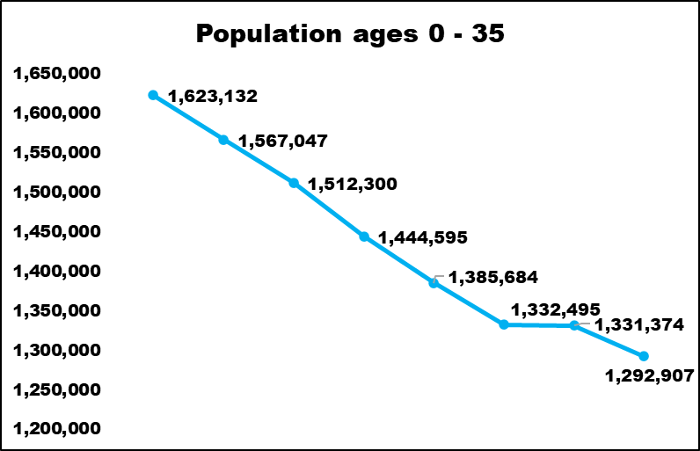
Total population for ages 0-35 in Puerto Rico
There is a noticeable decline in the total population for ages 0-35 in Puerto Rico from 2015 to 2022.
This downward trend observed between 2015 and 2022 indicates significant demographic shifts, indicating a decrease in the younger population cohort over the years.
Factors contributing to this decline may include migration, economic conditions, and birth rates.

Slide 13
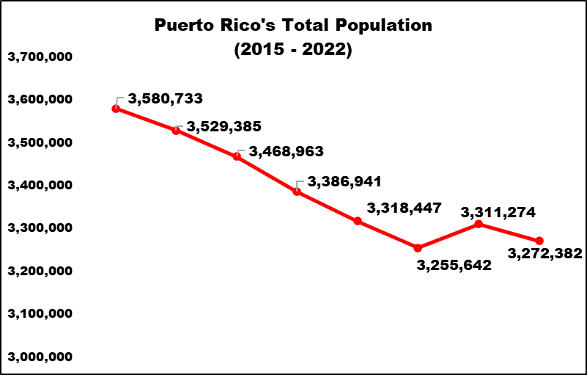
Total population in Puerto Rico (2015-2022)
The total population in Puerto Rico has exhibited a consistent downward trend from 2015 to 2022.
This decline suggests significant demographic changes and challenges within the territory.
Factors contributing to this trend may include migration patterns, economic conditions, and natural disasters such as Hurricane Maria in 2017.

Slide 14
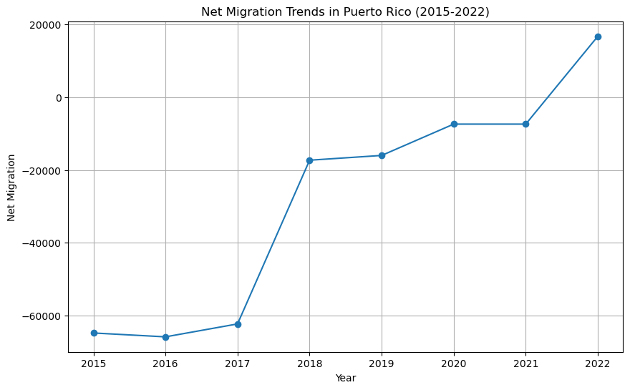
Net Migrate Data for PR (2015-2022)
From 2015 to 2017, there was a consistent negative net migration, indicating more people leaving Puerto Rico than moving in.
In 2018 and 2019, the negative net migration continues but at a reduced rate compared to previous years.
The decrease in negative net migration in 2020-2021, possibly due to events like the 2019-20 earthquakes and the pandemic, needs further examination. However, data accuracy during these years may affect conclusions about sustained migration trends from Puerto Rico.

Slide 15
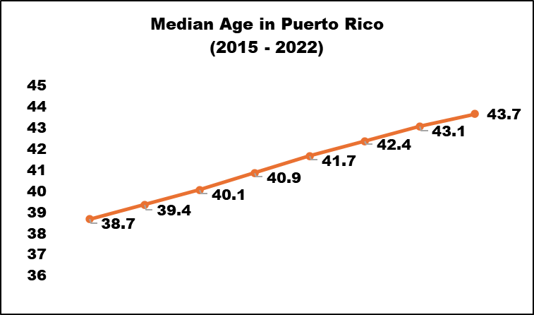
Median Age in PR (2015-2022)
The median age in Puerto Rico has shown a consistent upward trend from 2015 to 2022.
This increase indicates an aging population, suggesting a demographic shift towards older age groups over the years.
Although this doesn’t confirm the younger generations are leaving the island, it does confirm the population in general is trending to to an older one.

Slide 16
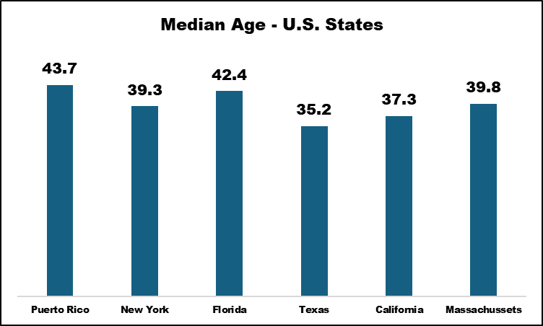
Comparison of Median Ages (States)
The median age is the age that divides a population into two numerically equal groups, meaning that half of the population is younger than this age and the other half is older.
It is a commonly used statistic to describe the age distribution of a population and can provide insights into demographic trends such as aging or youthfulness.
When compared to other U.S. States, Puerto Rico has an older median age, indicating the steady rise of an older population.

Slide 17
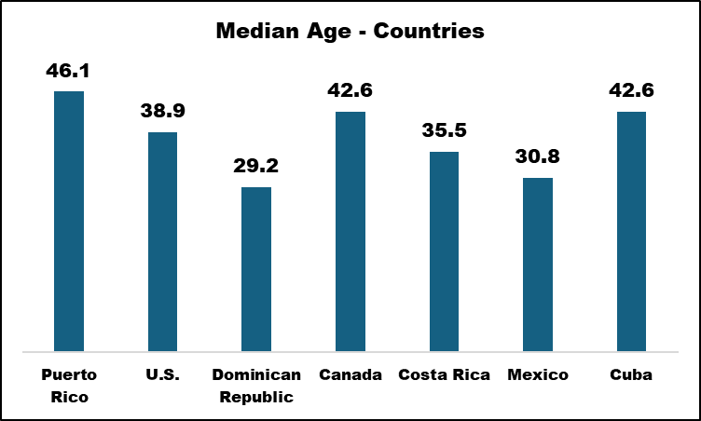
Comparison of Median Ages (Countries)
When compared to other countries in 2024, Puerto Rico’s median age is it 46.1 (CIA World Factbook citar)
The second highest is Canada and Cuba respectively, meanwhile the youngest is Dominican Republic.
This shows how different age is to neighboring countries who do have similarities in both culture and economy.

Slide 18
Conclusions
The data partially supports the hypotheses regarding demographic trends, policy influence, and natural disaster impacts on migration patterns in Puerto Rico, emphasizing the need for further analysis to understand the multifaceted factors driving population dynamics in the region.
Demographic Trend Hypothesis: [Approved]
The data indicates a consistent decline in the total population for ages 0-35 in Puerto Rico from 2015 to 2022.
This decline suggests a decrease in the younger population cohort over the years, supporting the hypothesis that younger individuals are migrating from Puerto Rico.
Policy Influence Hypothesis: [Inconclusive]
The implementation of PROMESA in 2016 coincides with a period of significant demographic changes in Puerto Rico.
While the data does not directly measure the impact of PROMESA on migration patterns, it provides insights into broader demographic trends during this period.
Natural Disaster Impact Hypothesis: [Approved]
The data shows a temporary surge in migration from Puerto Rico following natural disasters such as Hurricane Maria in 2017.
This supports the hypothesis that natural disasters can lead to increased migration as individuals seek refuge and opportunities elsewhere.

Slide 19
RESOURCES
U.S. Census Bureau. (n.d.). AGE AND SEX. American Community Survey, ACS 5-Year Estimates Subject Tables, Table S0101, 2015-2022. Retrieved Month Day, Year, from [Link](https://data.census.gov/table/ACSST5Y2020.S0101?moe=false)
World Bank. (n.d.). Net migration - Puerto Rico [Data file]. Retrieved Month Day, Year, from [Link](https://data.worldbank.org/indicator/SM.POP.NETM?end=2023&locations=PR&start=2015)

